Slide 1
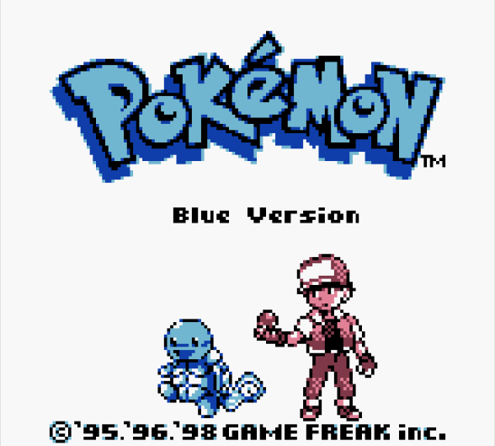
Progress Report 1
Project Definition & Requirements Specification
Team Blue

Slide 2
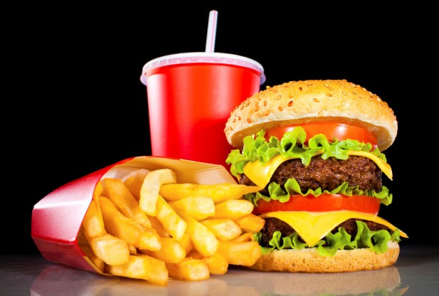
Project Definition
Why?
The average American spends $232 eating out per month [The Simple Dollar].
The average cost of eating out is $12.75 per meal, while the average cost of cooking at home is $6.41 per meal [Cheapism].
You take in an average of 200 more calories eating out than if you eat at home [The Independent].

Slide 3
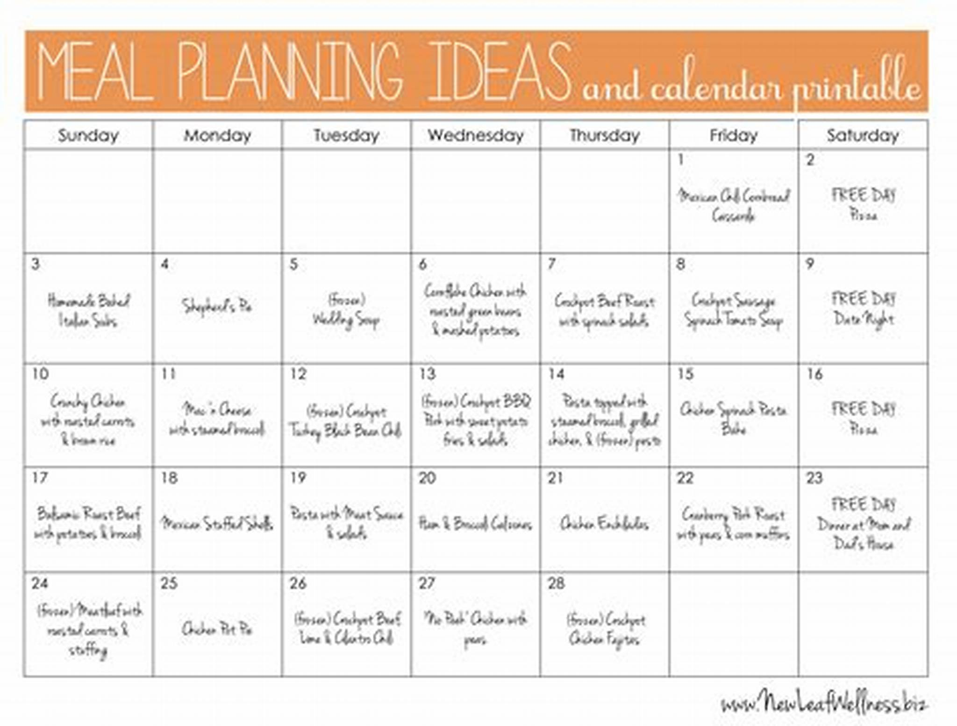

What?
Our goal is to make a user-friendly and intuitive meal planning application for the Android mobile platform. We hope to encourage people to eat healthier, save money, and improve their cooking ability.

Slide 4


How?
Edesia will allow the user to drag-and-drop different recipes into a day of the week. Users can search for recipes to add to their personal menu. If a user is unsure on what meal to cook, they can press a shuffle button and the application will select a variety of meals for that user.

Slide 5
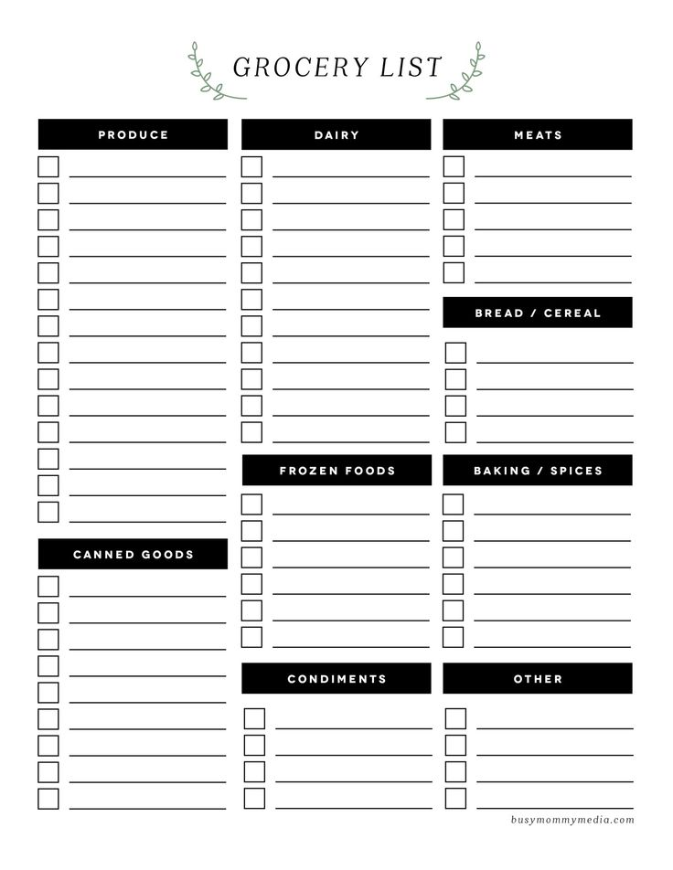
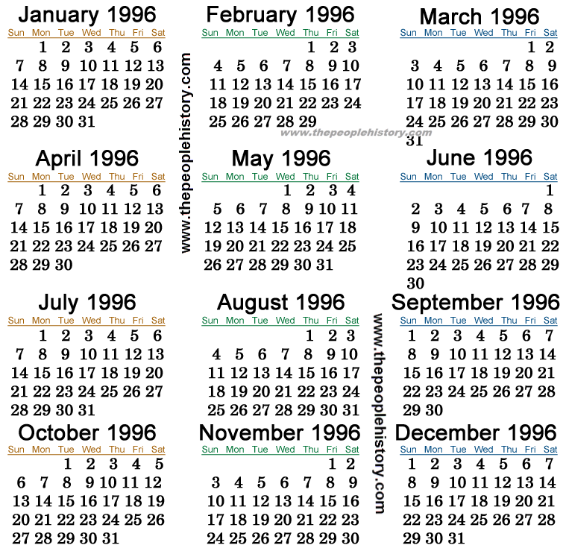

Project Requirements

Slide 6
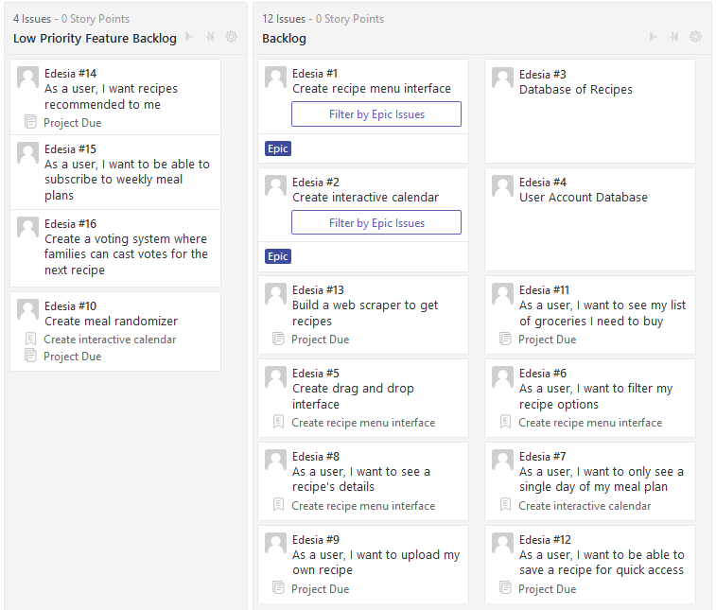
Functional
Drag-and-drop user interface
Interactive calendar
Database of recipes
Users can save recipes
Users can upload recipes
Filter recipe search
Automated grocery list

Slide 7
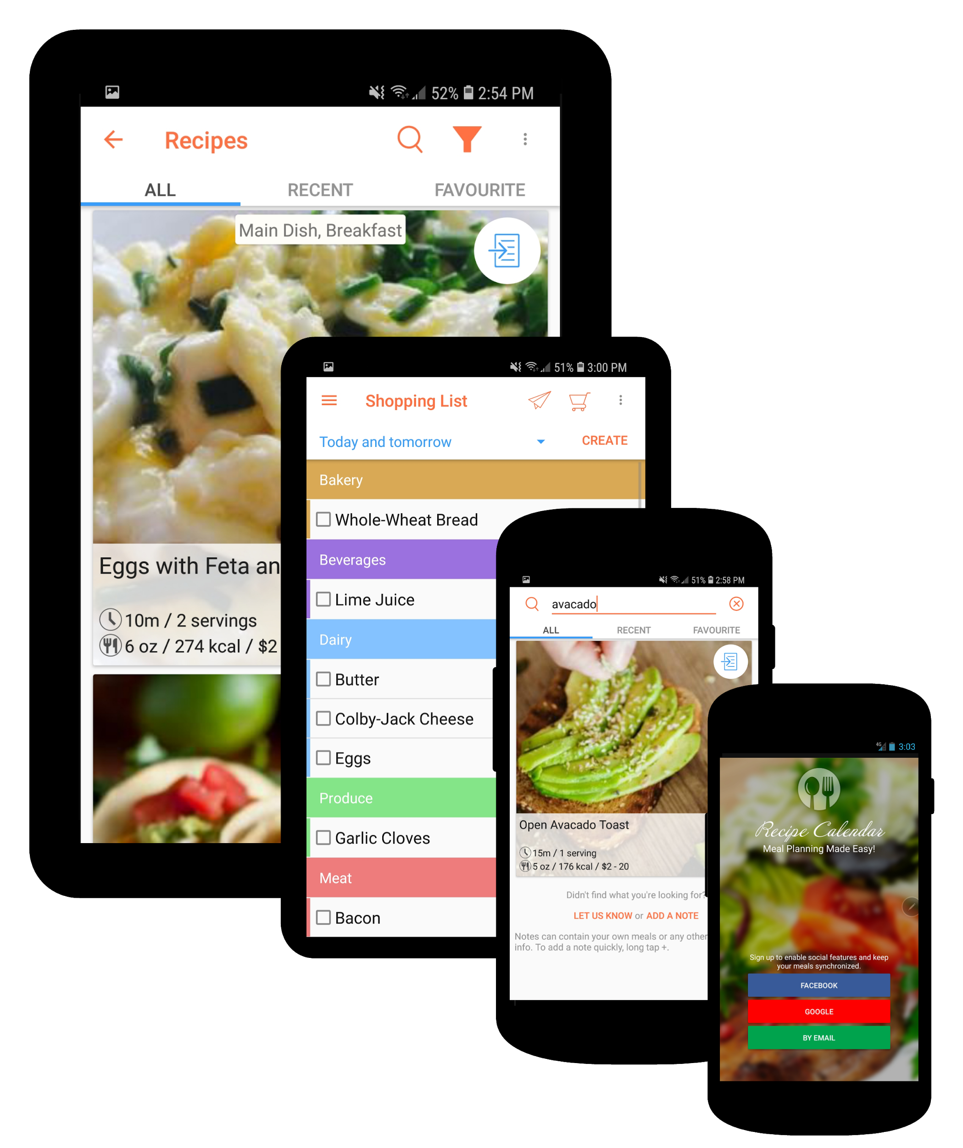
Usability
Designed with the smallest device in mind
Simple interface
Offers more in-depth features for advanced users.

Slide 8
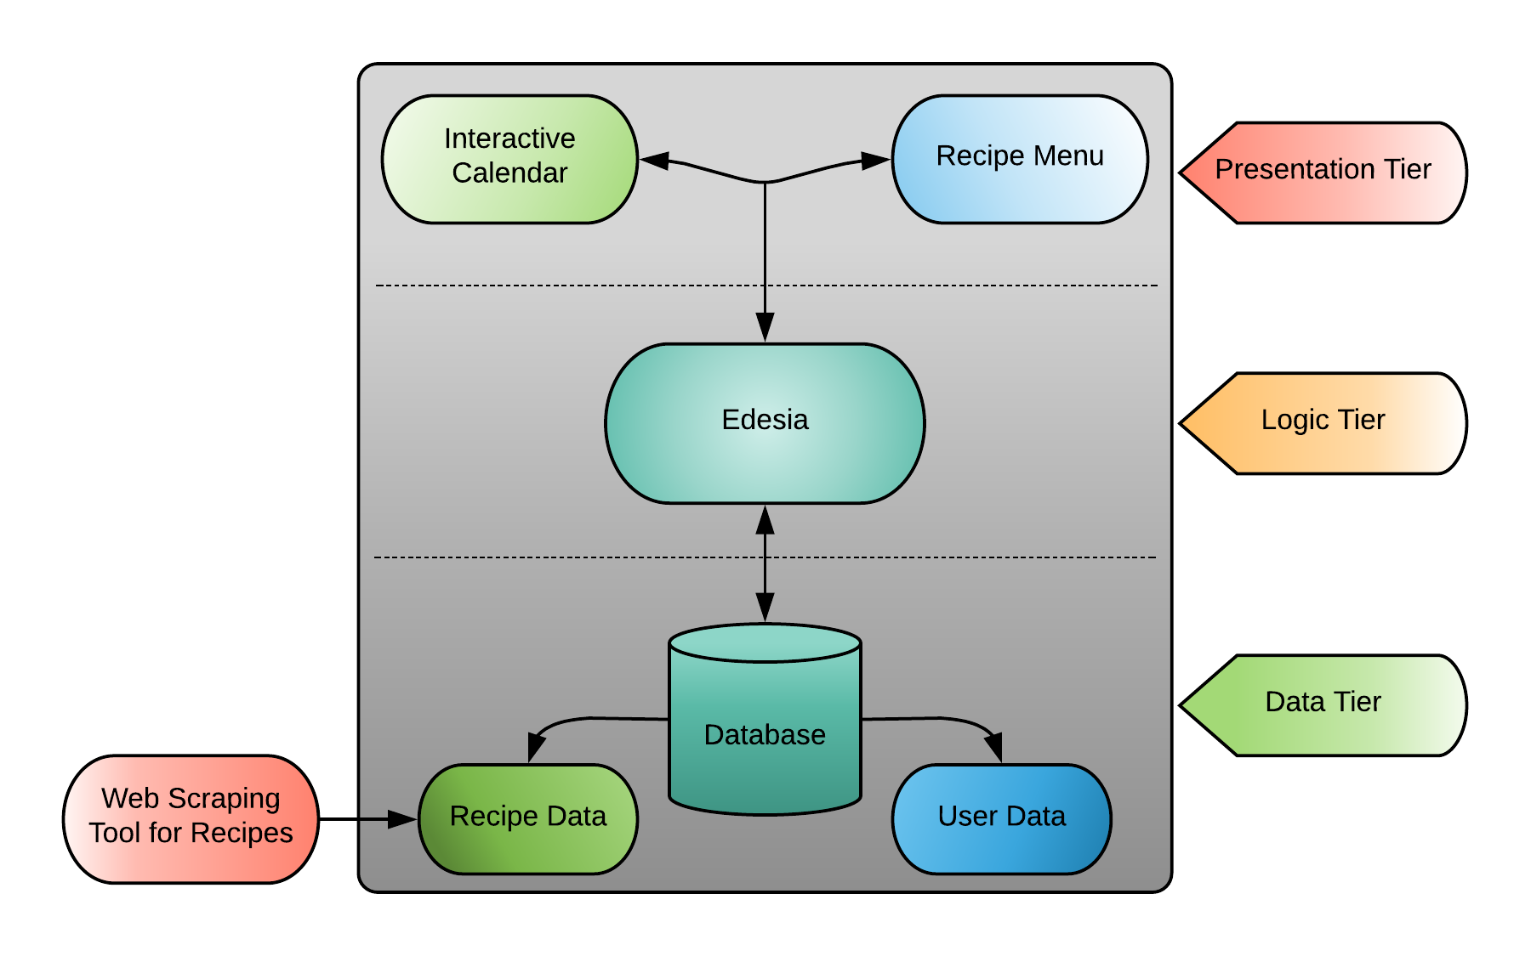
Three-Tier Architecture

Slide 9



System and Security
Hardware: Mobile devices(Android)
Software: Java, Javascript, C# using Android studio
Database: SQLite Database system seems to be the best from research
Use hash function(sha256) for encrypting sensitive user data into database
Scrub user input to prevent SQL injections

Slide 10

Project Specification
Focus / Domain / Area:
Foodies!
To help people organize their meals or
People who can't figure out what to cook
Libraries / Frameworks / Development Environment
Active android (helps with communication between app and SQLite)
Still researching what Framework may be best for what we want
Android Virtual Device (AVD)
Emulates Android OS within Android Studio
Web Scraping using Python Selenium and Scrapy libraries
Platform (Mobile, Desktop, Gaming, Etc): Mobile
Genre (Game, Application, etc): Food/Planning Application

